Slide 1

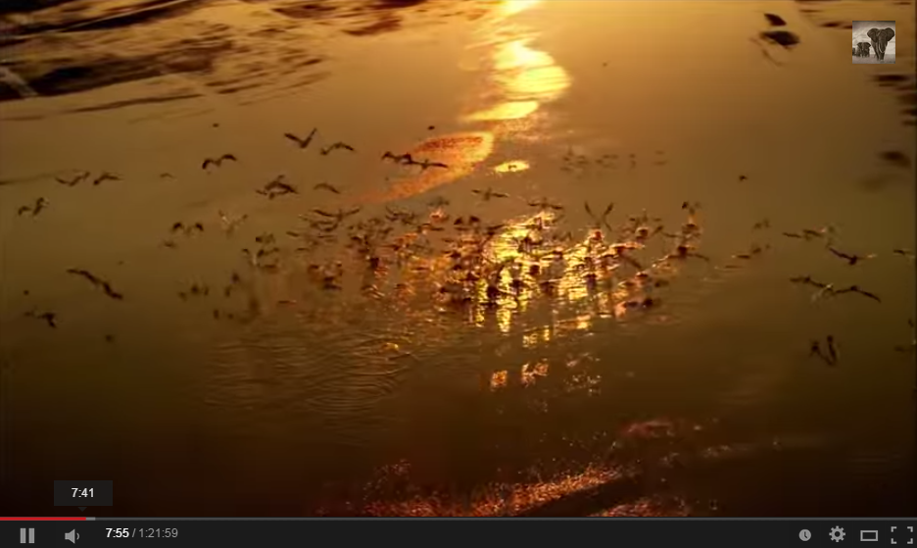

World Sustainability Fund
Post 2015 Agenda SDG 0.0 ?
Currencies Freed Labor
“160% Wealth”
Labor decoupled from Finance
No decoupling! Finance integrates to 0.00 inflation: saving Labor value
60% more wealth by decoupling labor registration from devaluating currencies. Including poverty eradication and pensions for all.
Emile van Essen
dLv
160%
Wealth
worldsustainabilityfund.nl
digital Labor value
Notes:
160% Wealth presentation

Slide 2
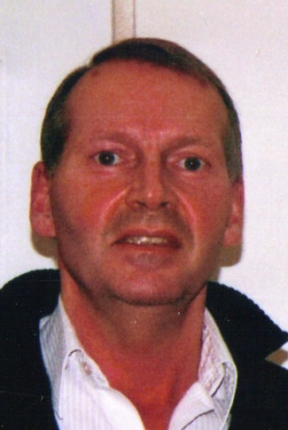
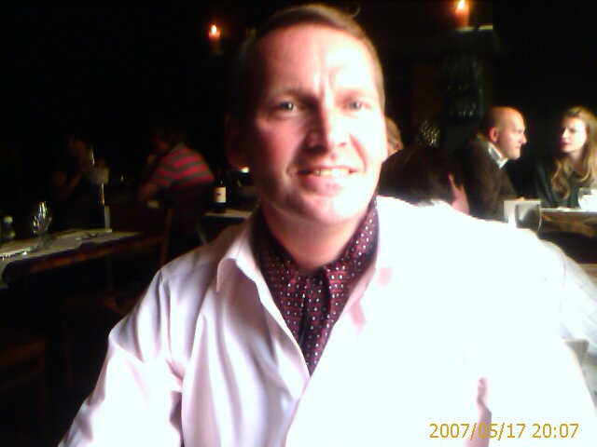
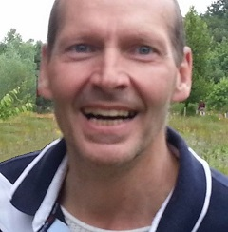
World Sustainability Fund
“160% Wealth”
Emile van Essen
dLv
160%
Wealth
worldsustainabilityfund.nl
digital Labor value
Notes:
Welcome at this first 160% Wealth Presentation.

Slide 3
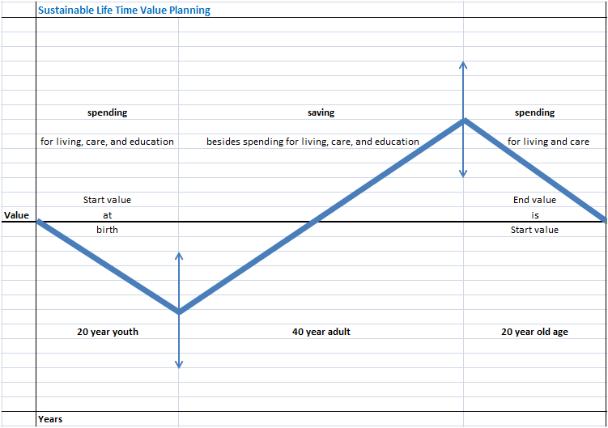
2020 Update
This presentation was built in 2014
In 2015 we studied time banks and found that they didn't solved income and credit
We recognized that credit is the key to labor and wealth
We developed the vision of Circular Life wealth support
We built a Model and developed a Service to launch in 2021, based this further presentation

Slide 4
Index
RECONSTRUCTED – BETA 2.
“160% Wealth”
Decoupling labor registration from currencies (becomes recovering values from inflation)
Labor participation and production factor
Recovering the 60% wealth
Local wealth & global fixed digital Labor value
Bonus for SDG jobs, malus for polluting jobs
Wage Share and impact on banking
Time to define the real value of our heritage
dLv
160%
Wealth
worldsustainabilityfund.nl
digital Labor value

Slide 5
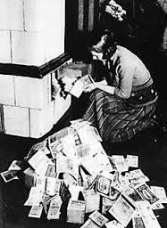
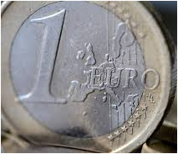
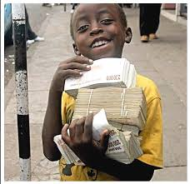
“160% Wealth”
Currency inflation lowers savings value
dLv
160%
Wealth
worldsustainabilityfund.nl
digital Labor value
Notes:
For centuries currency inflation was one of our greatest pains

Slide 6
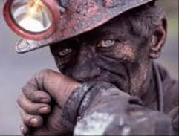
“160% Wealth”
Currency inflation lowers savings value
with a factor of 27 in the latest 112 years
dLv
160%
Wealth
worldsustainabilityfund.nl
digital Labor value
Notes:
At the reward of twenty seven hours labor in 1900 we can now buy only one hour service

Slide 7
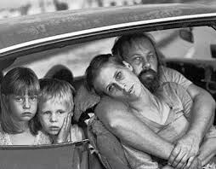
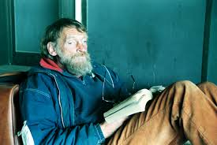
“160% Wealth”
And it is becoming worse, measured over an 80 years lifetime
Factor
dLv
160%
Wealth
Year 80 completed
worldsustainabilityfund.nl
digital Labor value
Notes:
And it is becoming worse. So it is at your interest to change this.

Slide 8
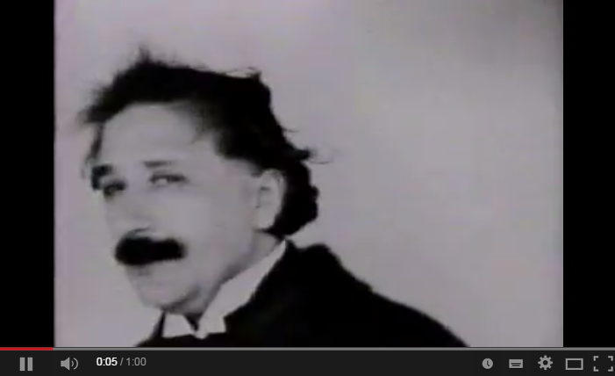
“160% Wealth”
Currency inflation lowered savings value
with a factor of 27 in the latest 112 years
dLv
160%
Wealth
worldsustainabilityfund.nl
digital Labor value

Slide 9
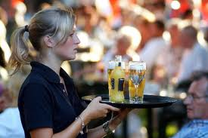
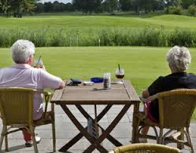
“160% Wealth”
Pension becomes this way three times more expensive than delivered work.
Euro
5,53
5,53
5,53
Age
dLv
160%
Wealth
1934
1974
2014
worldsustainabilityfund.nl
digital Labor value
Notes:
Many people fear to stay with empty hands, now and at pension

Slide 10


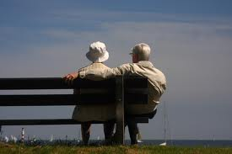
Age Sectors, Average price
“160% Wealth”
00 – 20 Education 1,17
20 – 60 Work 5,53
60 – 80 Pension 14,79
80 years Inflation Factor = 17,66 / 0,78 = 22,64
dLv
120%
Wealth
worldsustainabilityfund.nl
digital Labor value
Notes:
So we need to look what is really going on

Slide 11
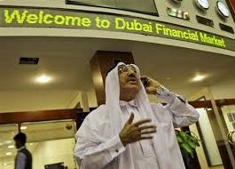
& Financial Volumes
“160% Wealth”
00 – 20 Education 1,17 x 20 year = 23,4
20 – 60 Work 5,53 x 40 year = 221,2
60 – 80 Pension 14,79 x 20 year = 295,8
Cost Volumes -23,4 - 295,8 = -319,2 -145%
Income Volume = 221,2 100%
Balance -98,0 -45%
Assuming one life cycle is representative
dLv
160%
Wealth
worldsustainabilityfund.nl
digital Labor value
Notes:
Realizing the present systems forces nearly all of us in debt. Both our governments and private

Slide 12
“160% Wealth”
Decoupling Labor registration from inflation, assuming a constant value of 5,53
Euro
5,53
5,53
5,53
dLv
Age 0 10 20 30 40 50 60 70 80
160%
Wealth
1934
1974
2014
worldsustainabilityfund.nl
digital Labor value
Notes:
So, what we need is a constant labor value, for getting back what we worked for

Slide 13
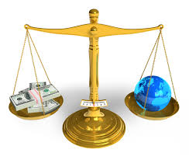
Inflation decoupled sector volumes
“160% Wealth”
00 – 20 Education 5,53 x 20 year = 110,6
20 – 60 Work 5,53 x 40 year = 221,2
60 – 80 Pension 5,53 x 20 year = 110,6
Cost Volumes -110,6 - 110,6 = -221,2 -100%
Income Volume = 221,2 100%
Balance 0 0%
The life cycle is now in labor balance
dLv
160%
Wealth
worldsustainabilityfund.nl
digital Labor value
Notes:
Because this will get our lives in balance. Offering an easy breakthrough with a prosper outlook

Slide 14


Conclusion 1.
“160% Wealth”
Decoupling labor value registration from inflating currencies will repair pension deficit and add 45% more value in a 40 years labor time and 80 years lifetime.
This can be realized by digital labor value registration. See also the Re-Bronning .ppt
dLv
It is that simple
160%
Wealth
worldsustainabilityfund.nl
digital Labor value
Notes:
Decoupling will repair pension deficit and add 60% more value to our lives

Slide 15
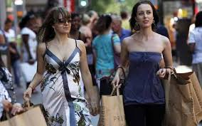
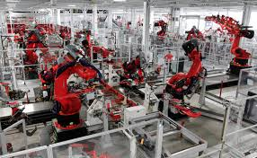
Labor participation & Labor factor
“160% Wealth”
Labor participation – How many people labor
Labor factor – or production factor – For how many others one labor produces
dLv
160%
Wealth
worldsustainabilityfund.nl
digital Labor value
Notes:
Now we will focuss on labor participation and contribution

Slide 16
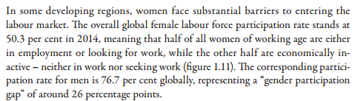
Labor Participation
“160% Wealth”
In 2013, 66,1% of the Dutch population aged between 15 to 65 years, had paid work for 12 hours or more per week.
ILO - WORLD OF WORK 2014
dLv
160%
Wealth
worldsustainabilityfund.nl
digital Labor value
Notes:
Only two third of available capacity have a more or less paid job

Slide 17
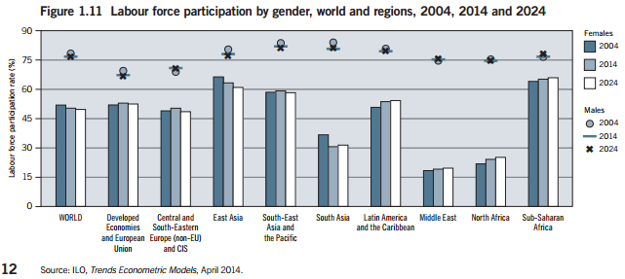
Labor Participation
“160% Wealth”
Partition aged to work, of which 6% unemployed
The gap will shrink. Underemployed regions will develop more employment
dLv
160%
Wealth
ILO - WORLD OF WORK 2014
worldsustainabilityfund.nl
digital Labor value
Notes:
Only two third of available capacity have a more or less paid job

Slide 18
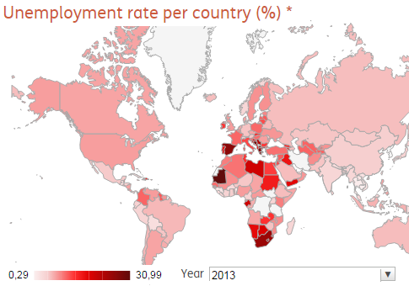
Unemployment
“160% Wealth”
Global unemployment rate 6%, 200 million people.
Decoupling labor from currencies will set free labor exchange. Unemployment will not relate to lack of funds.
So labor will flow. Halve or end the unemployment and give more access for females to get value for labor.
dLv
160%
Wealth
ILO - WORLD OF WORK 2014
worldsustainabilityfund.nl
digital Labor value
Notes:
They labor for their self and take so also care for the needs three others.

Slide 19
Labor Participation %
“160% Wealth”
Female 50,3 – 6 = 44,3 -> 60,0 – 3,0 = 57,0%
Male 76,7 – 6 = 70,7 -> 74,0 – 3,0 = 71,0%
Average 63,5% 57,5% 64,0%
Value growth 64,0% / 57,5% = 111%
Total labor value growth = 111% * 145% = 160%
dLv
160%
Wealth
ILO - WORLD OF WORK 2014
worldsustainabilityfund.nl
digital Labor value
Notes:
Only two third of available capacity have a more or less paid job. Decoupling will give 11% more labor participation and combined the 160% value growth

Slide 20
Labor Factor
“160% Wealth”
Total x 1000 | 2013 | 2013 | 2009 | Assume hours | x hours | hours % | hours %
Total population The Netherlands: | 16800 | 16800
 | # | %
Total population 15 till 65 year | 11013 | 65,55 |  | 38 | 418494 |  | 100
Professional population | 7939 |  | assume 7939
Laboring Professional population | 7283
Partime till 12 hour |  | 7,40 | 539 | 8 | 4312 | 1,76 | 1,03
Partime between 12 and 35 hour |  | 39,82 | 2900 | 24 | 69600 | 28,42 | 16,63
38 hour average |  | 61,79 | 4500 | 38 | 171000 | 69,82 | 40,86
Jobless Professional population | 656 |  |  |  | 244912 | 100 | 58,52
Non Professional population | 3074
 | %
Bruto labor participation | 72,09 | 47,26
Netto labor participation | 66,13 | 43,35 |  |  |  |  | 25,37%
Jobless Professional percentage | 8,26 | 5,42
Non Professional population | 27,91 | 52,74
43,35% x 58,52% = 25,37%
100% / 25,37% = 3,94
CBS
dLv
160%
Wealth
One labor produces for nearly four others
worldsustainabilityfund.nl
digital Labor value
Notes:
They labor for their self and take so also care for the needs three others.

Slide 21
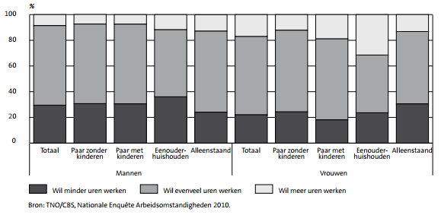
Labor wish NL
“160% Wealth”
10% like to labor more, 20% like to labor less
CBS
dLv
160%
Wealth
worldsustainabilityfund.nl
digital Labor value
Notes:
70% like that, 10% like to labor more, 20% less: Not measuring what the jobless and pensioners want!

Slide 22
Conclusion 2.
“160% Wealth”
Decoupling labor hour registration adds in total 60% more wealth x 4 = We are now able to rise the effective production factor to 6,4.
In The Netherlands 20% likes to labor less. This is possible.
In The Netherlands 10% likes to labor more. This is also possible: Decouple labor from currencies makes labor free exchangeable.
dLv
160%
Wealth
It is that simple
worldsustainabilityfund.nl
digital Labor value
Notes:
We are now able to rise the production factor from 4 times 160%, to 6,4. Both labor less and labor more will become easier

Slide 23
80 and 105 year forecast
“160% Wealth”
Assuming 2,5% average labor inflation becomes flat to 0,0% within 25 years
Labor savings value becomes value fixed
In the next 105 year
Factor
2096= 1,35
2120 = 1,0
dLv
160%
Wealth
worldsustainabilityfund.nl
digital Labor value
Notes:
It will take us a 100 year to get rid of inflation history and repair the deficits

Slide 24
Conclusion 3.
“160% Wealth”
80 and 100 year forecast
50% recovery at 2030
Factor
80% reco. at 2050
2096 = 1,35
>2120 = 1,0
36 year 105 year
dLv
From labor value inflation to stabilization
160%
Wealth
worldsustainabilityfund.nl
digital Labor value
Notes:
But the good news is we can recover 50% by 2030 and 80% at 2050

Slide 25
Impact from currency free labor
“160% Wealth”
People can start to exchange labor, also when they can not pay money for it: They can pay with labor in exchange – accounted on an digital individual ledger.
This will regenerate local wealth.
Setting for instance an age related maximum deficit level.
dLv
160%
Wealth
worldsustainabilityfund.nl
digital Labor value
Notes:
An extra freedom of decoupling is that we start to exchange labor free from having money. Which enables us to enter active in economics

Slide 26
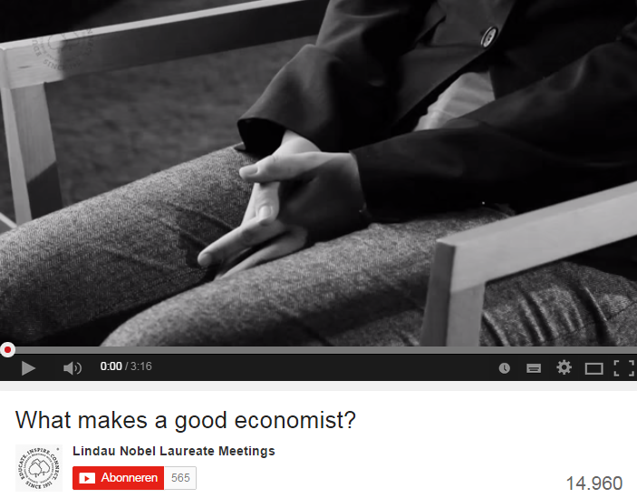
Impact from Currency Free Labor
“160% Wealth”
People can start to exchange labor, also when they can not pay money for it: They can pay with labor in exchange – accounted on an digital individual ledger.
This will regenerate local wealth.
Setting for instance an age related maximum deficit level.
dLv
160%
Wealth
worldsustainabilityfund.nl
digital Labor value

Slide 27
Fix ten global rates for labor value exchange:
“160% Wealth”
Lower Educated work 1 hour for 1 dLv (x160%)
Mid Educated work 1 hour for 1,2 dLv (x160%)
Mi & Skilled work 1 hour for 1,3 dLv (x160%)
Higher Educated work 1 hour for 1,4 dLv “ “
Hi Skilled work 1 hour for 1,5 dLv
Master Educated work 1 hour for 1,6 dLv
Ma & Skilled work 1 hour for 1,7 dLv
Post Master E&S work 1 hour for 1,8 dLv
Multi PM E&S International work 1/1,9 dLv
Multi PM E&S Global work 1/2,0 dLv
dLv
160%
Wealth
worldsustainabilityfund.nl
digital Labor value
Notes:
Also by internet, the labor market is now a global commons. Which need global pricing to avoid unequal concurrence and economic disasters.

Slide 28
Conclusion 4.
“160% Wealth”
Currency free labor will change local wealth
Global fixed labor value will stop unequal competition
Lowers intercontinental transport of goods
Sets free (over 50% of) transport labor
Slows down the use of burning fuels
Saving the planet a lot of CO2 emission
dLv
160%
Wealth
worldsustainabilityfund.nl
digital Labor value
Notes:
So decoupling will prosper local wealth, supports equality, is efficient and sustainable

Slide 29

Axes and Taxes
“160% Wealth”
The education based job reward can be seen as a vertical reward where priority and scarcity reward can be seen as a horizontal reward in time. Together they form the +.
Taxes can be seen as a third dimension axis, winging reward the needed surrounding to support the job and balancing the job related effects in society.
dLv
160%
Wealth
worldsustainabilityfund.nl
digital Labor value
Notes:
So decoupling will prosper local wealth, supports equality, efficienty and sustainabiliy

Slide 30
Regular taxation for all jobs
“160% Wealth”
Like in the present, financial currency related, tax systems, dLv – digital Labor value – has to be taxed.
dLv divides 1 hour unit labor in for instance:
78% hour saving direct to the laborers ledger;
4% hour saving to his pension;
2% to his job insurance;
16% to government.
dLv
160%
Wealth
worldsustainabilityfund.nl
digital Labor value
Notes:
Taxes has still to be paid

Slide 31
Priority and Scarcity Reward
“160% Wealth”
SDG: Sustainable Development Goals
Priority Bonus for SDG jobs:
Reward x1,3 for SDG creating jobs
Reward x1,2 for SDG jobs
Reward x1,1 for SDG related jobs
Malus counter SDG productive jobs:
Tax x1,15 for high pollution jobs
Tax x1,10 for average pollution jobs
Tax x1,05 for low pollution jobs
dLv
160%
Wealth
worldsustainabilityfund.nl
digital Labor value
Notes:
And the right jobs can get a bonus paid by the polluting ones

Slide 32
Conclusion 5.
“160% Wealth”
SDG priority jobs can become extra rewarded by taxing polluting jobs.
Regular tax systems can stay: the will become partial dLv based, from which government can balanced pay it needed labor.
It benefits what is needed.
dLv
160%
Wealth
worldsustainabilityfund.nl
digital Labor value
Notes:
Reward systems can help governments to gain positive impact on their Post 2015 Development Agenda

Slide 33
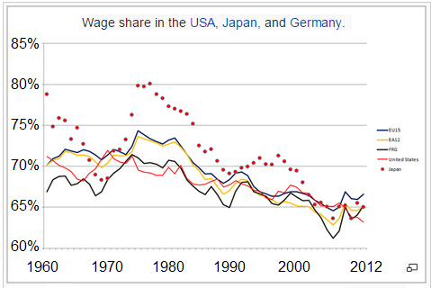
Wage Share ex Banking
“160% Wealth”
Wage share is 65% of GDP
dLv takes labor value out of the commercial banking and into governments registration
Correcting the impact of banking on economy
dLv
160%
Wealth
wiki/Wage_share
worldsustainabilityfund.nl
digital Labor value
Notes:
Labor is 65% of our production value. It need commons safekeeping

Slide 34

Governments in charge
“160% Wealth”
dLv
It benefits what is needed.
160%
Wealth
worldsustainabilityfund.nl
digital Labor value

Slide 35
Tooling
“160% Wealth”
dLv can be at start tooled by an extra line in accounting systems, and LET or Bitcoin alike open source software, operated by the community, but not connected to financial values;
To integrate in national and international tax systems extra developments steps are needed
New legislation will develop out of early start ups: both for providers and users.
dLv
160%
Wealth
worldsustainabilityfund.nl
digital Labor value
Notes:
Integrating dLv in daily life needs open source software and governments protection

Slide 36
Conclusion 6.
“160% Wealth”
Community and governments will manage dLv registration systems as a non commercial act
Companies & private will book into the dLvRS
Commercial banks will loss a part of their function: 65% of Salary Payment & Savings
Labor is also to pay a added value part in money
It’s to early to measure dLv impact on banks
dLv
160%
Wealth
It is that simple
worldsustainabilityfund.nl
digital Labor value
Notes:
Community and Governments will manage dLv, banks will lose business, but money will be still some 35% of the reward of commercial jobs

Slide 37
Resources value
“160% Wealth”
Human labor is the only source of Wealth
Surrounding can be less or more a Bron: by Field, Creations - Matter, Energy, Space, Time.
The Economic Wealth value (Rv) of FC-MEST depends on need and scarcity:
Rv = (Lv + FC-MESTv) x Trade Skills
FC-MESTvaluation needs evaluation.
dLv
160%
Wealth
worldsustainabilityfund.nl
digital Labor value
Notes:
Wealth is only what we can experience by processing it. Entering the final chapter, about the eight Resources parameters: Resource value is trade skills times labor plus field values.

Slide 38
FC-MEST & Trade Skills value
“160% Wealth”
Cv was based upon “replacing labor costs, food value, or happiness value.”
Mv was based on market price x TS
TS = Seller TS / Buyer TS
Ev was based on production cost.
Sv was created by land/city scarcity politics: “City space price in the free market.”
Tv was created by “time partial usership.”
dLv
160%
Wealth
worldsustainabilityfund.nl
digital Labor value
Notes:
Defining the resources values: Creations, Matter, Trade skills, Energy, Space, and Time.

Slide 39

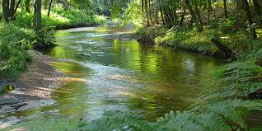
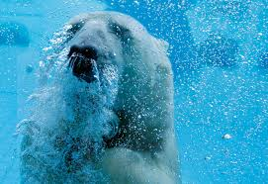
Field value
“160% Wealth”
What is the value of an ambiance?
A family?
A biotope?
A country?
Our planet?
Having defined all other components, they can only be revaluated by their value in the Field.
dLv
160%
Wealth
worldsustainabilityfund.nl
digital Labor value
Notes:
How do we value the Field and how relate the components to that all?

Slide 40
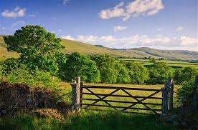
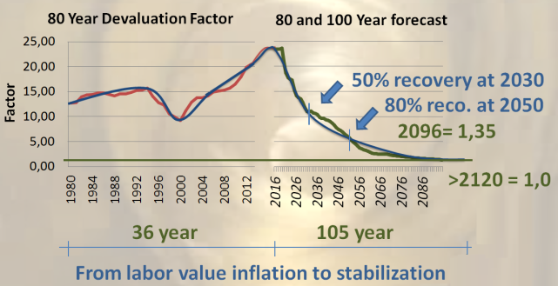
Conclusion 7.
“160% Wealth”
It becomes time to define the real value of our heritage, to trade / law it free for our children.
This will become the discussion for the next 15 years.
Now we are able to create “160% Wealth”, we will find time to get this right.
dLv
160%
Wealth
worldsustainabilityfund.nl
digital Labor value
Notes:
It becomes time to trade and law free our heritage. Able to create “160% Wealth”, we will get this right too

Slide 41
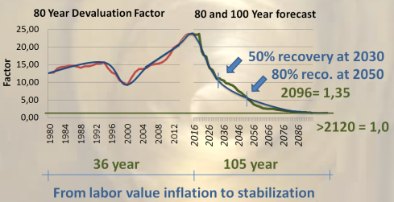
Conclusion Summary
“160% Wealth”
dLv
1&2. Decoupling labor value registration from inflating currencies, will set free flow of labor, add 60% wealth, and rises the effective production factor to 6,4;
50% recovery at 2030, 80% at 2050;
a. Currency free labor will change local wealth;
b. Global fixed labor value stops unequal competition;
c. Slows down the use of burning fuels;
a. SDG jobs can become extra rewarded by taxing polluting jobs;
b. Regular tax systems can stay;
dLv will downsize commercial banking and prosper Gov’s
It becomes time to define the real value of our heritage, to trade / law it free for our children.
160%
Wealth
dLv
160%
Wealth
worldsustainabilityfund.nl
digital Labor value
Notes:
We will get 60% more wealth: 30% by 2030 and near 50% by 2050. Plus extra local prosperity, equal global competition, and a boost on sustainable development. The production factor will rise from under 4 to over 6. Lower influence of banks and strengthen governments, so we will be able to fry our heritage

Slide 42
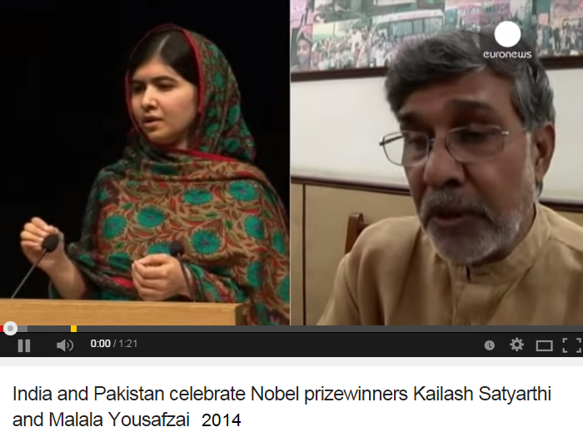
To set free children and Elder
“160% Wealth”
dLv
160%
Wealth
50% recovery at 2030
80% recovery at 2050
100% at 2120
From labor value inflation to 160% Wealth
dLv
160%
Wealth
worldsustainabilityfund.nl
digital Labor value

Slide 43
It’s worth doing the recovery
“160% Wealth”
dLv
160%
Wealth
50% recovery at 2030
80% recovery at 2050
100% at 2120
From labor value inflation to 160% Wealth
dLv
160%
Wealth
worldsustainabilityfund.nl
digital Labor value
Notes:
Poor countries will need this first of all, but developed countries need to hurry with implemetation too, to gain back their comfort

Slide 44
“160% Wealth”
dLv
World Sustainability Fund
supports 160% Wealth
implementation on local,
Country, and global level.
160%
Wealth
dLv
160%
Wealth
worldsustainabilityfund.nl
digital Labor value
Notes:
You can do this with the help of the World Sustainability Fund

Slide 45
“160% Wealth”
dLv
160%
Wealth
Post 2015 Agenda SDG 0.0 ?
Currencies Freed Labor
The Next Industrial Revolution
Emile van Essen
"I wish you 160% Wealth."
dLv
160%
Wealth
worldsustainabilityfund.nl
digital Labor value
Notes:
Thank you for being here. Think: What can I do to grab the 160% Wealth for myself, my family, and for all of us. I wish you 160% Wealth.

